Slide 1
Applications of Linear Systems
Gaurav bhattarai
Roll 10

Slide 2
Linear systems are fundamental to many engineering disciplines, allowing us to model and solve complex real-world problems. From electrical circuits to structural analysis, understanding the applications of linear systems is crucial for success in the field.
Here are some common applications:
Regression Analysis: Linear systems are used in regression models to analyze relationships between variables and make predictions based on observed data.
Structural Analysis: Linear systems are used to analyze the forces and stresses acting on structures like bridges, buildings, and dams.
Network Analysis: Linear systems are used to model and analyze computer networks, including traffic flow and routing algorithms.
Sales Forecasting: Linear systems can be used to forecast sales based on historical data and market trends.

Slide 3
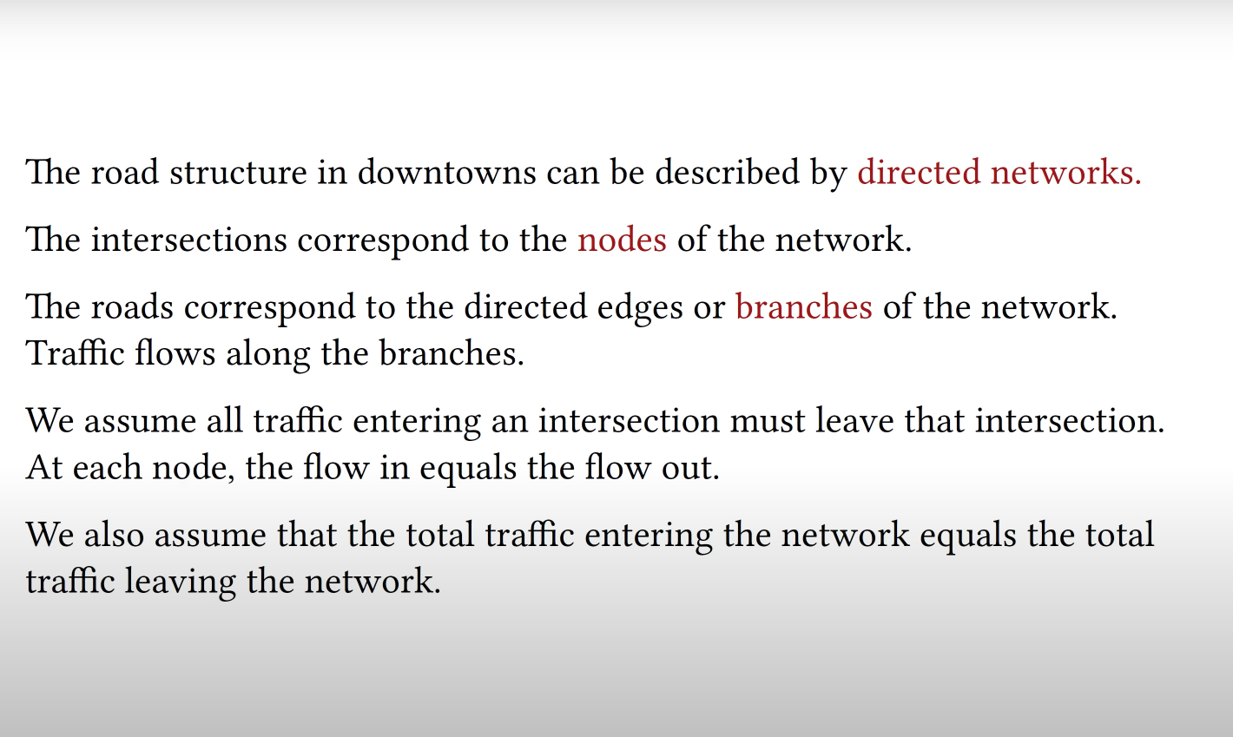
EXAMPLE:
assumptions

Slide 4
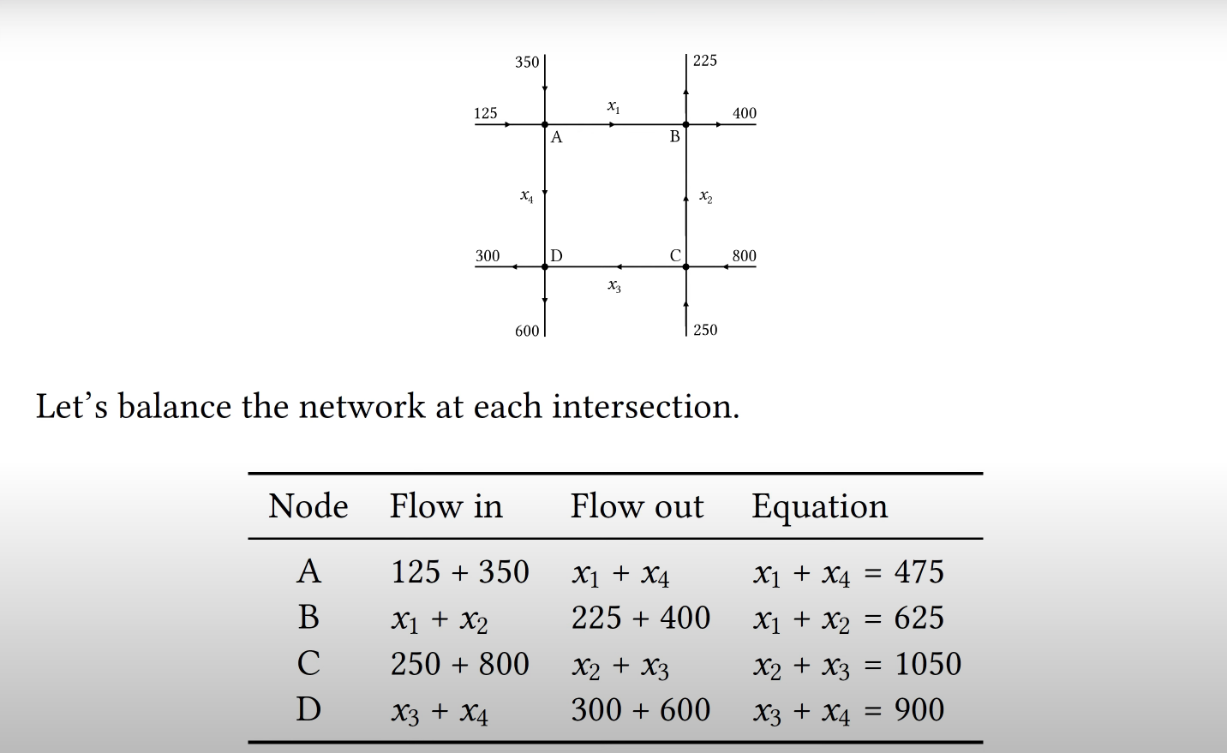

Slide 5
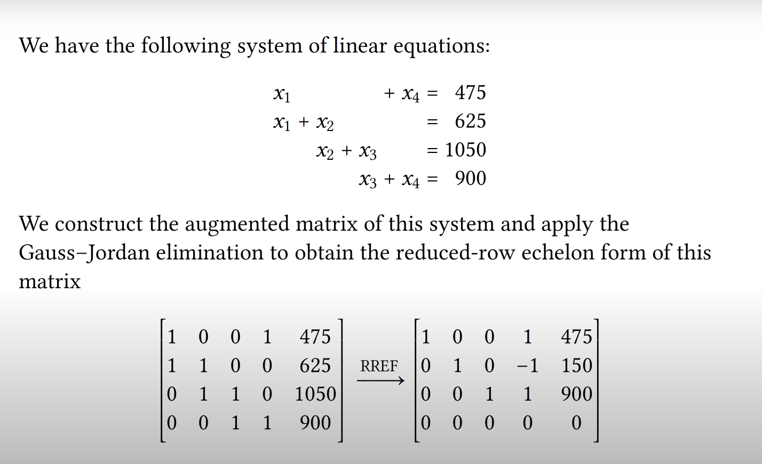

Slide 6
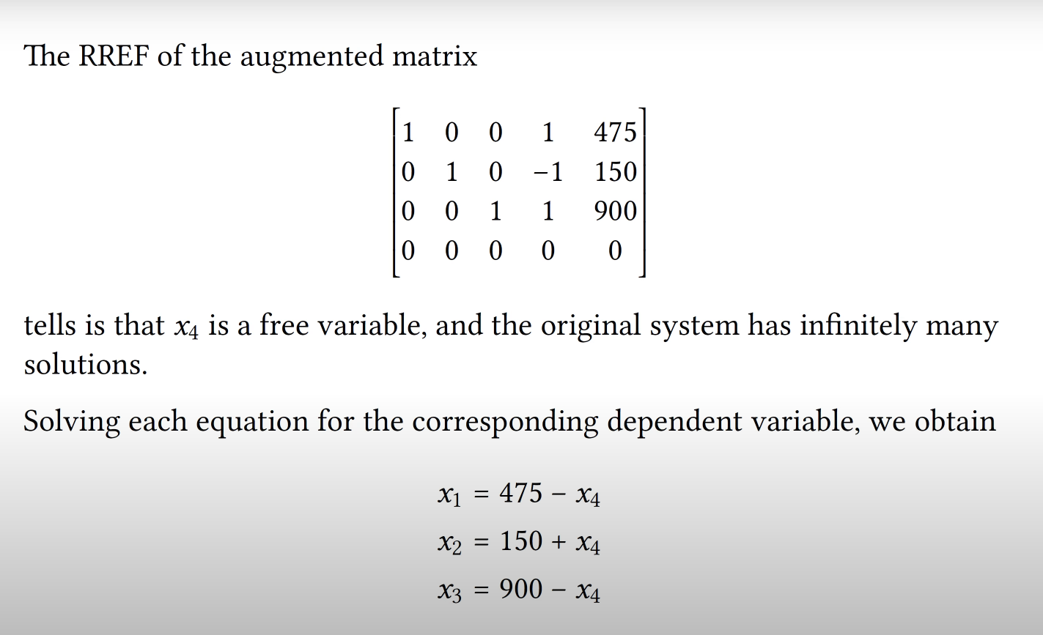

Slide 7
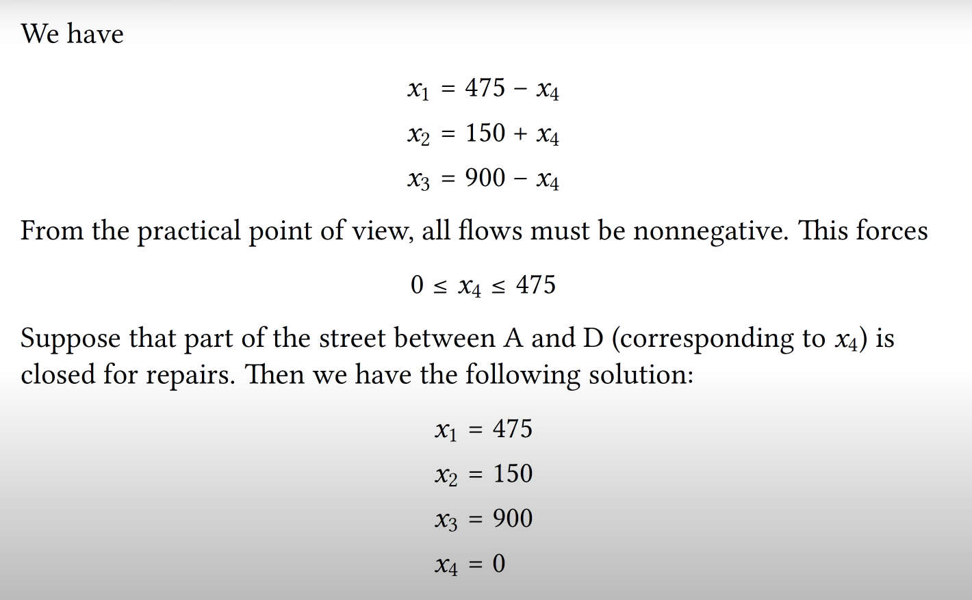

Slide 8
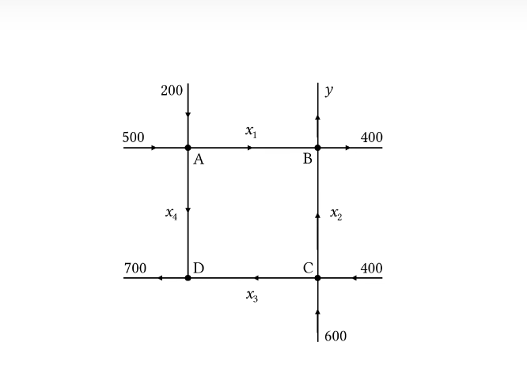

Slide 9
THANK YOU
ANY QUESTIONS?

